Slide 1


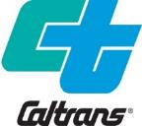

December 13, 2019
I-80 Corridor Update

Slide 2
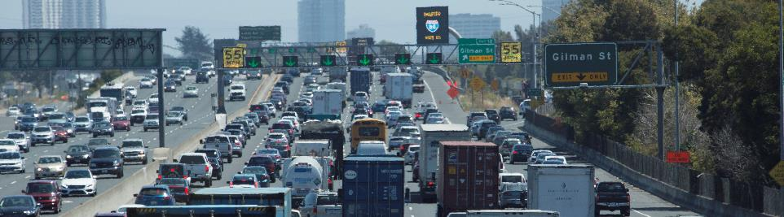
Agenda
I-80 Smart Corridor Update
Managed (HOV) Lane Update
Upcoming Initiatives and Projects on I-80

Slide 3
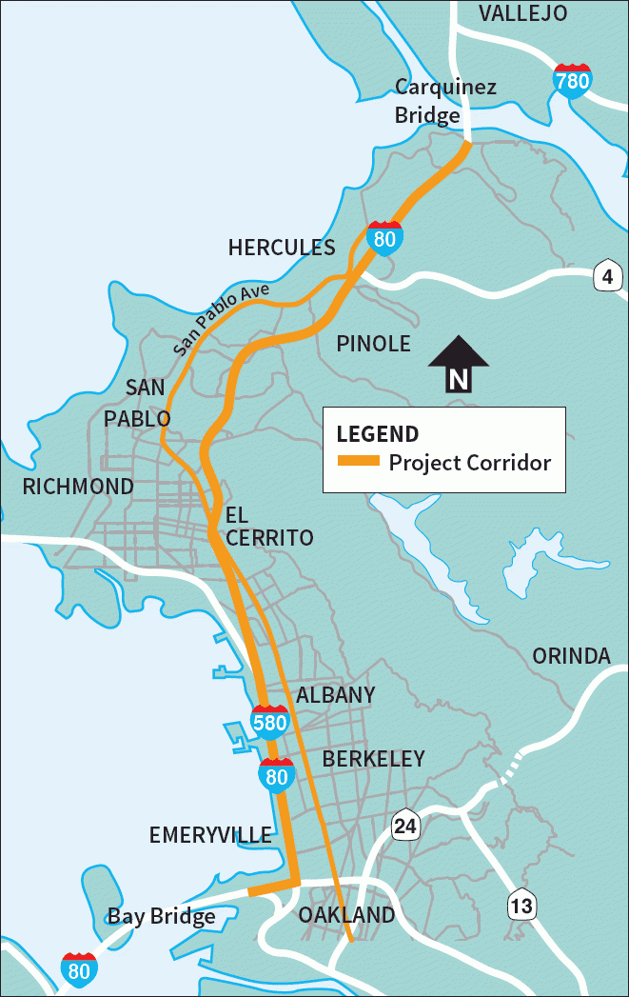
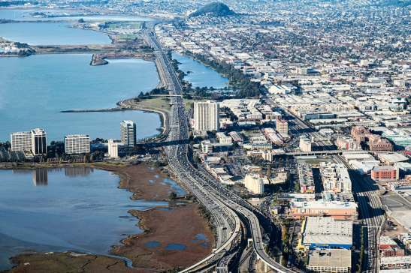
I-80 Smart Corridor Overview
What is the I-80 Smart Corridor?
Implementation of operational strategies and technologies to improve mobility, safety and interagency communications.
Adaptive Ramp Metering
Active Traffic Management
Transit Signal Priority
Traffic Signal Coordination
Incident Management
Traffic Data Sharing
Enhanced Traveler Information
Notes:
DEMONSTRATE AN INCIDENT

Slide 4
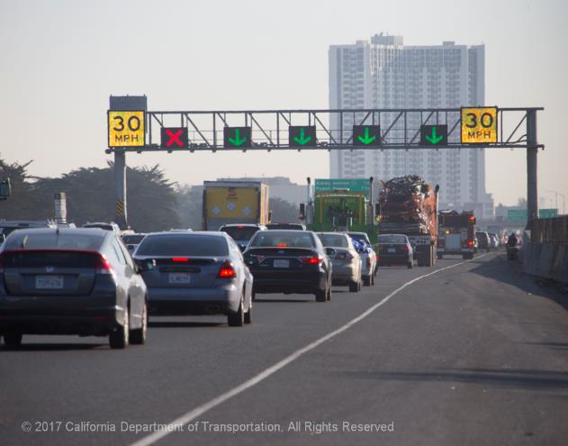
I-80 Smart Corridor Update
Caltrans proactively operating, monitoring & fine-tuning
Total Activations of System: 1141*
    WB I-80: 836
    EB I-80: 305
    Overhead Signs (WB): 523
After Study (2014 – 2017)
  Demand
  Mobility
  Safety
  Bottlenecks
Variable Advisory Speed Sign
Lane Use Signs
* As of 7/31/2019

Slide 5
Increasing Demand
7-10%

Slide 6
Gantries on WB I-80 only
Congestion from 5AM to 8PM
INRIX

Slide 7
PM Peak Expansion
Demand increased significantly, minimal travel times increase
INRIX

Slide 8
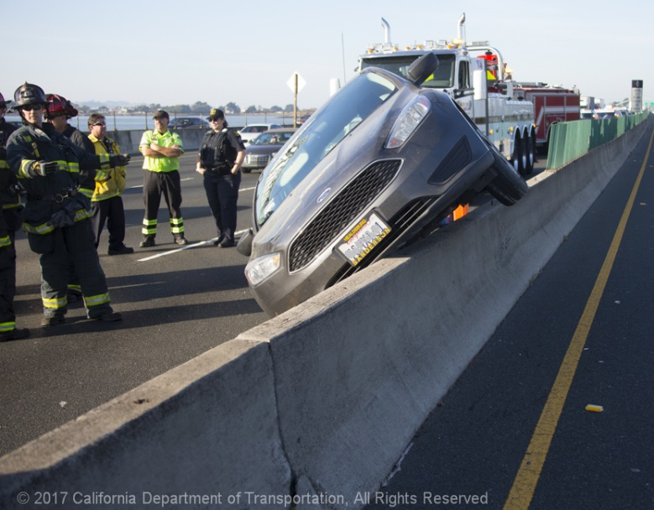
Safety Benefits
WB I-80 has highest density of Smart Corridor elements including gantries
WB I-80 rear-end accidents decreased
All Highways and Freeways in Alameda and Contra Costa Counties: Collisions increased an average of 12 percent between 2014 and 2017

Slide 9
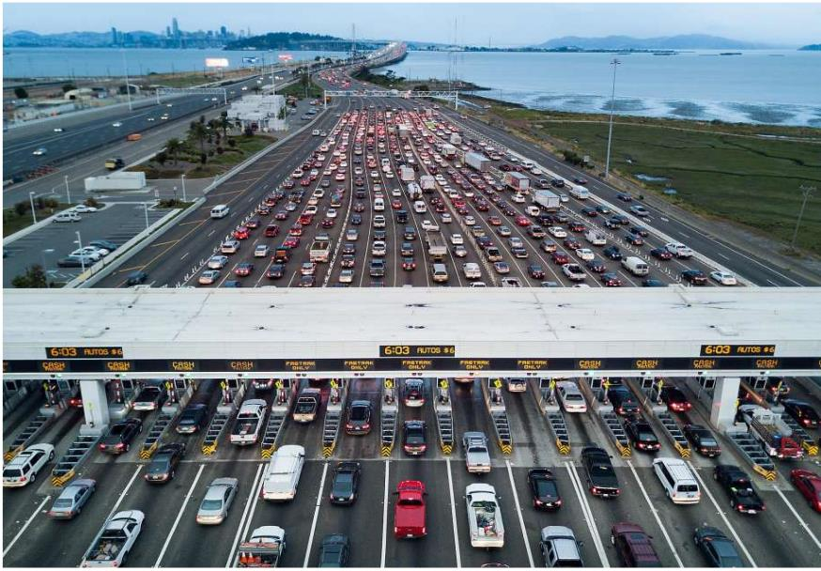
Improving Bottlenecks
# of Bottlenecks Unchanged
Examples of Bottlenecks Locations:
  WB I-80:
    Bay Bridge Toll Plaza
    “Maze”
    I-580 Merge
  EB I-80:
    Gilman to I-580 Interchange
    San Pablo Dam Rd
    Pinole Valley Rd
Improved throughput through bottlenecks
  Freeway is more productive

Slide 10
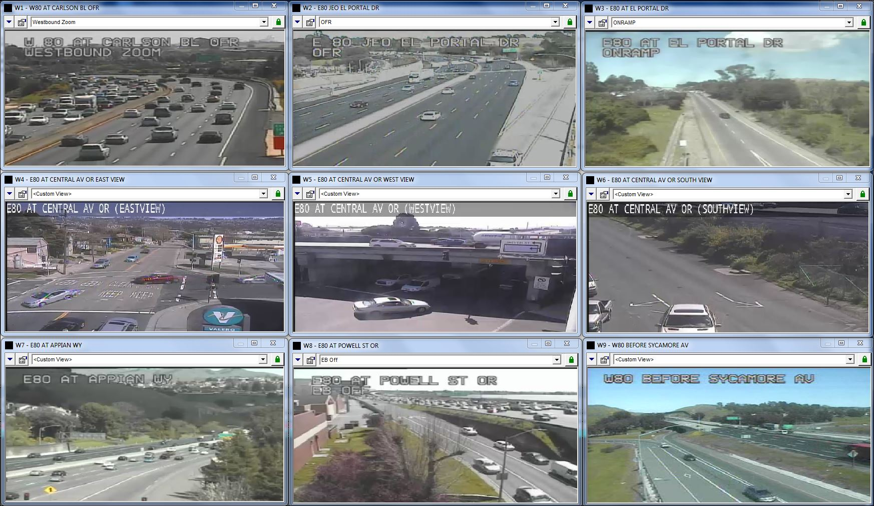
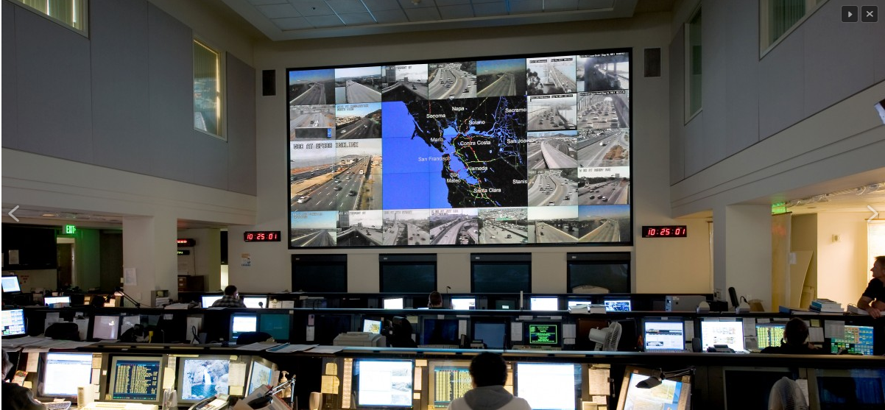
Committed to the Corridor
Where Can We Help?
Daily Activities
  Monitor CCTV, vehicle detectors and Smart Corridor systems
  Investigate complaints
  Timing adjustments
Weekly Activities
    Review performance measures
    Coordination with Construction
Quarterly or Monthly Activities
    I-80 Technical Advisory Committee and Management Updates
Dedicated Corridor Manager and Team
  6:00am to 6:00pm engineer staffing
Transportation Management Center

Slide 11
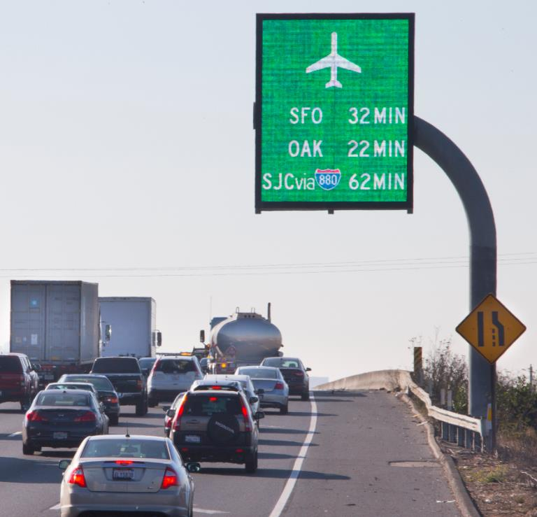
Summary
Improved Mobility and Safety
  Corridor performance would have been worse without Smart Corridor
  Freeway was more productive
  WB I-80 saw most improvements
Proof of Concept For the Future
  Active Traffic Management
  Innovative Traveler Information
  Coordinated Incident Management
  Adaptive Ramp Metering
  Regional Data Sharing

Slide 12
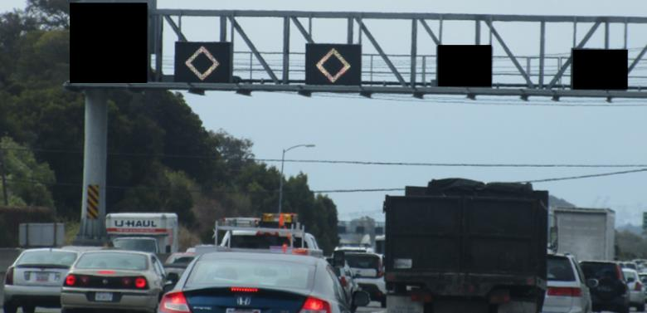
Managed Lane Update
Caltrans Monitors Managed Lane and HOV Performance
  Annual Report
  Consults with FHWA
  Data Collection Challenge:
    Labor intensive process with Caltrans and Consultant teams
      Human Factors
        Tinted Windows
        Children
        Viewing Angles
    Evaluating automation technologies
Display HOV Symbol on Lane Use Signs During Operating Hours (WB Only)
    1 Year Pilot Starting Fall 2019
Enhanced Enforcement

Slide 13
Enhanced Enforcement Update
Ongoing Partnership with MTC and CHP
MTC allocated additional $600,000 of funds for enforcement in FY19/20
  $1.8 million total through June 30, 2020.
  Approximately $1.1 million available July 1, 2019 and beyond
FY 18/19 Statistics:
  11,800 enforcement contacts
  80% were for HOV occupancy citations or warnings
  7900+ Citations Issued
  1400+ Warnings
Analysis ongoing

Slide 14
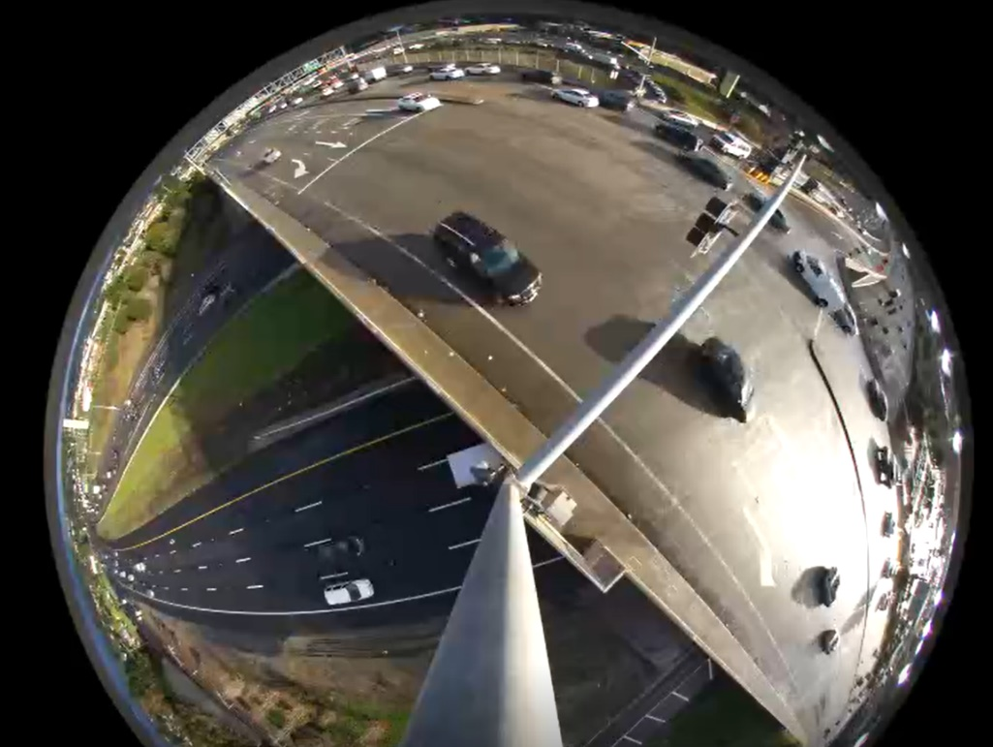
Upcoming Projects and Initiatives
Collaboration with Regional Partners and MTC
  SF-Oakland Bay Bridge Metering Lights Upgrade
    “Smart” Adaptive System
  Bay Bridge Forward
    Improve Transit Access
    Commuter Parking at I-80 / Buchannan
      Opening Spring 2020
  Port of Oakland: GoPort Freight
Adaptive Traffic Signal System Deployments
Implementation of Variable Advisory Speeds on I-80
New Technology Pilots

Slide 15
Planned Caltrans Projects in Contra Costa County

Slide 16

Questions
David Man
Caltrans District 4
Supervising Transportation Engineer
David.Man@dot.ca.gov

